Slide 1
Lecture 12
Games
Yaohang Li
Department of Computer Science
ODU
Reading for This Class:
Chapter 7, Russell and Norvig

Slide 2
Review
Last Class
Games
Adversarial Search
This Class
Pruning a Game Tree
Next Class
Knowledge-based Agent

Slide 3
Imperfect Decisions
complete search is impractical for most games
Even though we can prune the tree
alternative:
search only part of the tree
Cutoff required
requires a cutoff-test to determine where to stop
use a heuristics-based evaluation function to estimate the expected utility of the game from a given position

Slide 4
Evaluation Function
determines the performance of a game-playing program
must be consistent with the utility function
values for terminal nodes must be the same
tradeoff between accuracy and time cost
without time limits, minimax could be used
should reflect the actual chances of winning
frequently weighted linear functions are used
E = w₁ f₁ + w₂ f₂ + … + w_{n} f_{n}
combination of features, weighted by their relevance

Slide 5
Example: Tic-Tac-Toe
simple evaluation function
E(s) = (rx + cx + dx) - (ro + co + do)
where r,c,d are the numbers of row, column and diagonal lines still available; x and o are the pieces of the two players
1-ply lookahead
start at the top of the tree
evaluate all 9 choices for player 1
pick the maximum E-value
2-ply lookahead
also looks at the opponents possible move
assuming that the opponents picks the minimum E-value

Slide 6
Tic-Tac-Toe 1-Ply
E(s0) = Max{E(s11), E(s1n)} = Max{2,3,4} = 4
E(s11)
8
- 5
= 3
E(s12)
8
- 6
= 2
E(s13)
8
- 5
= 3
E(s14)
8
- 6
= 2
E(s15)
8
- 4
= 4
E(s16)
8
- 6
= 2
E(s17)
8
- 5
= 3
E(s18)
8
- 6
= 2
E(s19)
8
- 5
= 3
X
X
X
X
X
X
X
X
X

Slide 7
Tic-Tac-Toe 2-Ply
E(s0) = Max{E(s11), E(s1n)} = Max{2,3,4} = 4
E(s1:1)
8
- 5
= 3
E(s1:2)
8
- 6
= 2
E(s1:3)
8
- 5
= 3
E(s1:4)
8
- 6
= 2
E(s1:5)
8
- 4
= 4
E(s1:6)
8
- 6
= 2
E(s1:7)
8
- 5
= 3
E(s1:8)
8
- 6
= 2
E(s1:9)
8
- 5
= 3
X
X
X
X
X
X
X
X
X
E(s2:41)
5
- 4
= 1
E(s2:42)
6
- 4
= 2
E(s2:43)
5
- 4
= 1
E(s2:44)
6
- 4
= 2
E(s2:45)
6
- 4
= 2
E(s2:46)
5
- 4
= 1
E(s2:47)
6
- 4
= 2
E(s2:48)
5
- 4
= 1
O
O
O
X
X
X
O
X
X
O
X
X
X
O
O
O
E(s2:9)
5
- 6
= -1
E(s2:10)
5
-6
= -1
E(s2:11)
5
- 6
= -1
E(s2:12)
5
- 6
= -1
E(s2:13)
5
- 6
= -1
E(s2:14)
5
- 6
= -1
E(s2:15)
5
-6
= -1
E(s2:16)
5
- 6
= -1
O
X
X
O
X
X
X
X
X
X
O
O
O
O
O
O
E(s21)
6
- 5
= 1
E(s22)
5
- 5
= 0
E(s23)
6
- 5
= 1
E(s24)
4
- 5
= -1
E(s25)
6
- 5
= 1
E(s26)
5
- 5
= 0
E(s27)
6
- 5
= 1
E(s28)
5
- 5
= 0
X
O
X
O
X
X
X
X
X
X
O
O
O
O
O
O

Slide 8
Checkers Case Study
initial board configuration
Black single on 20 single on 21 king on 31
Red single on 23 king on 22
evaluation function E(s) = (5 x₁ + x₂) - (5r₁ + r₂)
where
x₁ = black king advantage,
x₂ = black single advantage,
r₁ = red king advantage,
r₂ = red single advantage
₁
₂
₃
₄
₅
₆
₇
₈
₉
₁₀
₁₁
₁₂
₁₃
₁₄
₁₅
₁₆
₁₇
₁₈
₁₉
₂₀
₂₁
₂₂
₂₃
₂₄
₂₅
₂₆
₂₇
₂₈
₂₉
₃₀
₃₁
₃₂

Slide 9
Checkers Minimax Example
₁
₂
₃
₄
1
₅
₆
₇
₈
₉
₁₀
₁₁
₁₂
20 -> 16
31 -> 27
₁₃
₁₄
₁₅
₁₆
21 -> 17
31 -> 26
MAX
₁₇
₁₈
₁₉
₂₀
₂₁
₂₂
₂₃
₂₄
₂₅
₂₆
₂₇
₂₈
1
0
-8
-8
₂₉
₃₀
₃₁
₃₂
MIN
23 -> 30
23 -> 32
22 -> 31
22 -> 26
22 -> 13
22 -> 17
22 -> 18
22 -> 25
23 -> 26
23 -> 27
6
1
1
6
1
2
0
-4
-8
-8
MAX
16 -> 11
16 -> 11
31 -> 27
31 -> 27
31 -> 27
31 -> 24
20 -> 16
21 -> 14
31 -> 27
20 -> 16
31 -> 27
21 -> 17
21 -> 17
16 -> 11
20 -> 16
21 -> 17
31 -> 26
20 -> 16
6
1
1
1
1
1
1
1
1
1
1
6
1
1
1
1
2
0
0
0
-4
-4
-8
-8
-8
-8

Slide 10
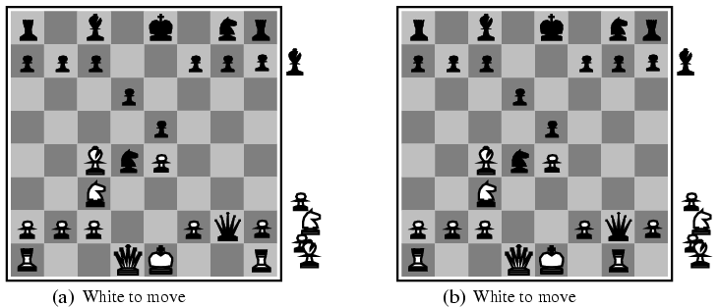
Difficulty in Evaluation Function
Very difficult to develop an appropriate evaluation function
Example
Two slightly different chess positions
A. black has an advantage of a knight and two pawns and will win the game
B. back will lose after white captures the queen

Slide 11
Horizon Problem
moves may have disastrous consequences in the future, but the consequences are not visible
the corresponding change in the evaluation function will only become evident at deeper levels
they are “beyond the horizon”
determining the horizon is an open problem without a general solution
only some pragmatic approaches restricted to specific games or situation

Slide 12
Pruning
discards parts of the search tree
guaranteed not to contain good moves
high likelihood that the solution is not in the branch or subtree
results in substantial time and space savings
the leftover part of the task may still be exponential, however

Slide 13
Mathematics under Pruning
MINIMAX-VALUE(root) =max(min(3,12,8), min(2,x,y),min(14,5,2))
=max(3, min(2,x,y), 2)
In such a case, regardless what value x and y will be, it wouldn’t affect the minimax value.

Slide 14
Alpha-Beta Pruning
moves that with certainty won’t result in a better evaluation value than a move further up in the tree are not considered
they would lead to a less desirable outcome
applies to moves by both players
α indicates the best choice for Max so far never decreases
β indicates the best choice for Min so far never increases
extension of the minimax approach
results in the same move as minimax, but with less overhead
prunes uninteresting parts of the search tree

Slide 15
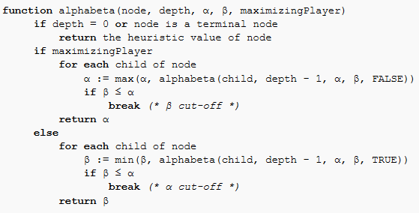

Alpha-Beta Algorithm

Slide 16
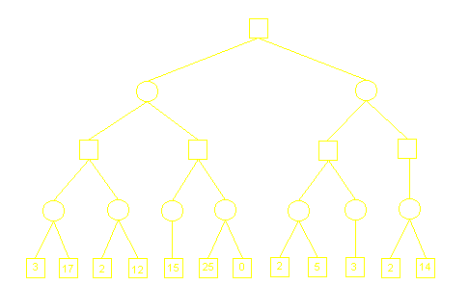
Alpha-Beta Pruning Example

Slide 17

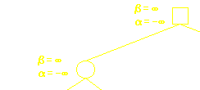
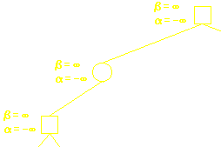
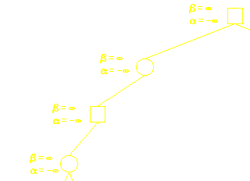
Alpha-Beta Pruning Example

Slide 18
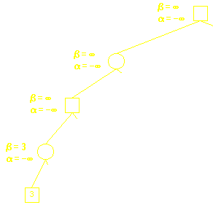
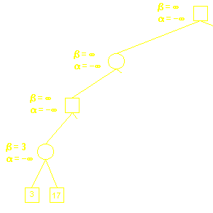
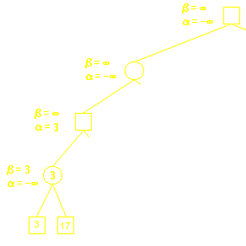
Alpha-Beta Pruning Example

Slide 19
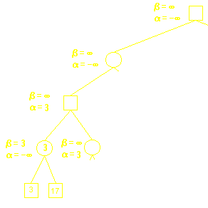
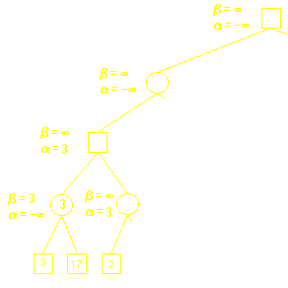
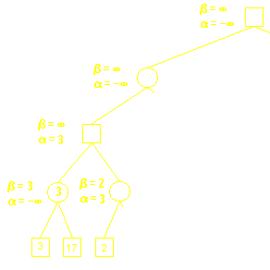
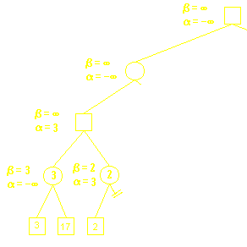
Alpha-Beta Pruning Example

Slide 20
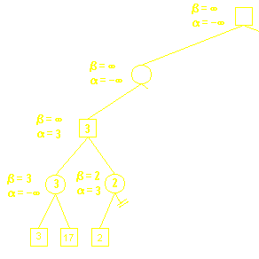
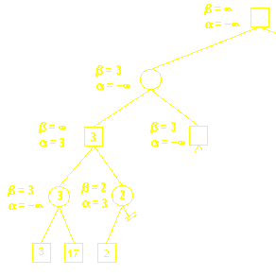
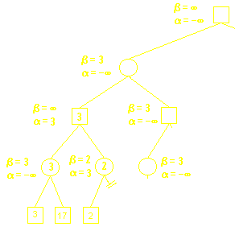
Alpha-Beta Pruning Example

Slide 21
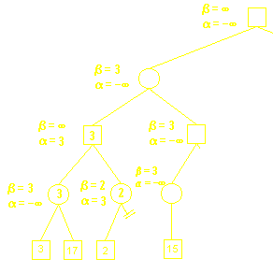
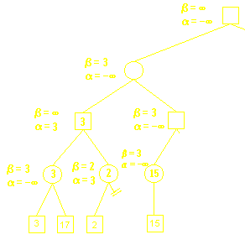
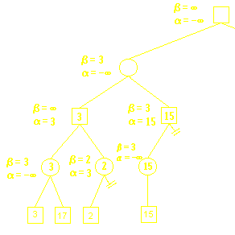
Alpha-Beta Pruning Example

Slide 22
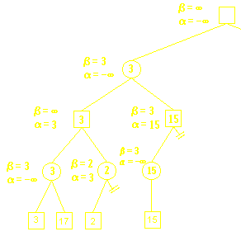

Alpha-Beta Pruning Example

Slide 23
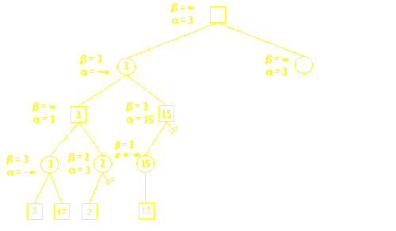
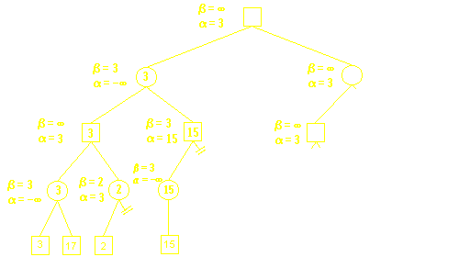
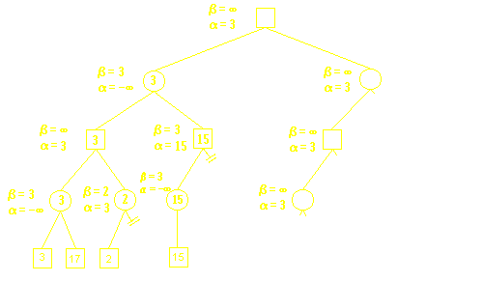
Alpha-Beta Pruning Example

Slide 24
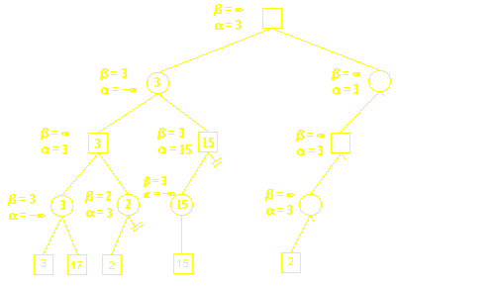
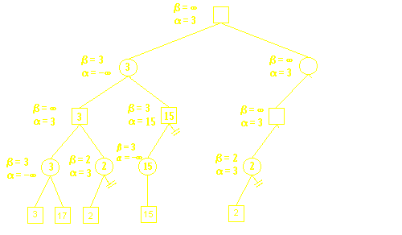
Alpha-Beta Pruning Example

Slide 25
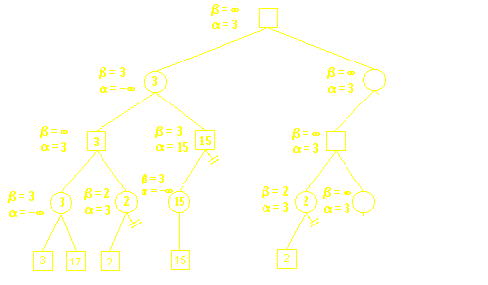
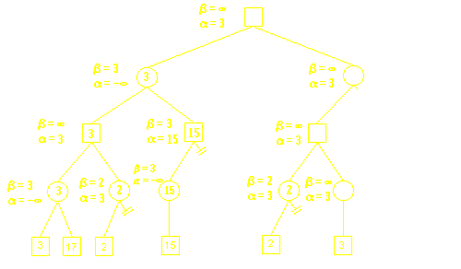

Alpha-Beta Pruning Example

Slide 26


Alpha-Beta Pruning Example

Slide 27
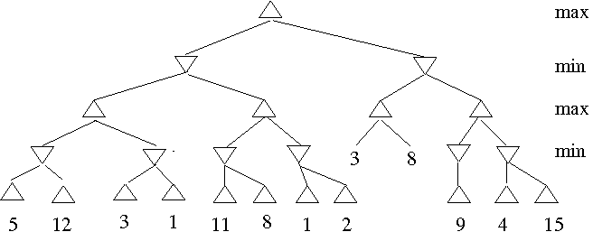
Exercise

Slide 28
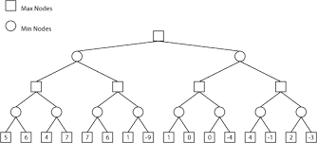
Exercise

Slide 29
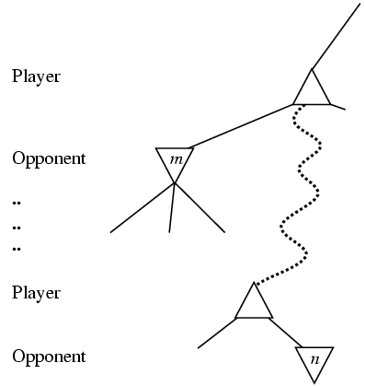
The general case of Alpha-Beta Pruning
If m is better than n for Player, we will never get to n to play
This is Alpha-cutting

Slide 30
Checkers Alpha-Beta Example
₁
₂
₃
₄
1
₅
₆
₇
₈
₉
₁₀
₁₁
₁₂
α -∞
β 6
MAX
31 -> 26
₁₃
₁₄
₁₅
₁₆
20 -> 16
₁₇
₁₈
₁₉
₂₀
21 -> 17
31 -> 26
₂₁
₂₂
₂₃
₂₄
₂₅
₂₆
₂₇
₂₈
₂₉
₃₀
₃₁
₃₂
1
0
-4
-8
MIN
23 -> 30
23 -> 32
22 -> 31
22 -> 26
22 -> 18
22 -> 17
22 -> 18
22 -> 25
23 -> 26
23 -> 27
6
1
1
6
1
2
0
-4
-8
-8
MAX
16 -> 11
16 -> 11
31 -> 27
31 -> 27
31 -> 27
31 -> 24
20 -> 16
21 -> 14
31 -> 27
20 -> 16
31 -> 27
21 -> 17
21 -> 17
16 -> 11
20 -> 16
21 -> 17
31 -> 26
20 -> 16
6
1
1
1
1
1
1
1
1
1
1
6
1
1
1
1
2
0
0
0
-4
-4
-8
-8
-8
-8

Slide 31
Checkers Alpha-Beta Example
₁
₂
₃
₄
1
₅
₆
₇
₈
₉
₁₀
₁₁
₁₂
α -∞
β 1
MAX
31 -> 26
₁₃
₁₄
₁₅
₁₆
20 -> 16
₁₇
₁₈
₁₉
₂₀
21 -> 17
31 -> 26
₂₁
₂₂
₂₃
₂₄
₂₅
₂₆
₂₇
₂₈
₂₉
₃₀
₃₁
₃₂
1
0
-4
-8
MIN
23 -> 30
23 -> 32
22 -> 31
22 -> 26
22 -> 18
22 -> 17
22 -> 18
22 -> 25
23 -> 26
23 -> 27
6
1
1
6
1
2
0
-4
-8
-8
MAX
16 -> 11
16 -> 11
31 -> 27
31 -> 27
31 -> 27
31 -> 24
20 -> 16
21 -> 14
31 -> 27
20 -> 16
31 -> 27
21 -> 17
21 -> 17
16 -> 11
20 -> 16
21 -> 17
31 -> 26
20 -> 16
6
1
1
1
1
1
1
1
1
1
1
6
1
1
1
1
2
0
0
0
-4
-4
-8
-8
-8
-8

Slide 32
Checkers Alpha-Beta Example
₁
₂
₃
₄
α -∞
β 1
1
₅
₆
₇
₈
₉
₁₀
₁₁
₁₂
MAX
31 -> 26
₁₃
₁₄
₁₅
₁₆
20 -> 16
₁₇
₁₈
₁₉
₂₀
β− cutoff: no need to
examine further branches
21 -> 17
31 -> 26
₂₁
₂₂
₂₃
₂₄
₂₅
₂₆
₂₇
₂₈
₂₉
₃₀
₃₁
₃₂
1
0
-4
-8
MIN
23 -> 30
23 -> 32
22 -> 31
22 -> 26
22 -> 18
22 -> 17
22 -> 18
22 -> 25
23 -> 26
23 -> 27
6
1
1
6
1
2
0
-4
-8
-8
MAX
16 -> 11
16 -> 11
31 -> 27
31 -> 22
31 -> 27
31 -> 24
20 -> 16
21 -> 14
31 -> 27
20 -> 16
31 -> 27
21 -> 17
21 -> 17
16 -> 11
20 -> 16
21 -> 17
31 -> 26
20 -> 16
6
1
1
1
1
1
1
1
1
1
1
6
1
1
1
1
2
0
0
0
-4
-4
-8
-8
-8
-8

Slide 33
Checkers Alpha-Beta Example
₁
₂
₃
₄
α -∞
β 1
1
₅
₆
₇
₈
₉
₁₀
₁₁
₁₂
MAX
31 -> 27
₁₃
₁₄
₁₅
₁₆
20 -> 16
₁₇
₁₈
₁₉
₂₀
21 -> 17
31 -> 26
₂₁
₂₂
₂₃
₂₄
₂₅
₂₆
₂₇
₂₈
₂₉
₃₀
₃₁
₃₂
1
0
-4
-8
MIN
23 -> 30
23 -> 32
22 -> 31
22 -> 26
22 -> 18
22 -> 17
22 -> 18
22 -> 25
23 -> 26
23 -> 27
6
1
1
6
1
2
0
-4
-8
-8
MAX
16 -> 11
16 -> 11
31 -> 27
31 -> 22
31 -> 27
31 -> 24
20 -> 16
21 -> 14
31 -> 27
20 -> 16
31 -> 27
21 -> 17
21 -> 17
16 -> 11
20 -> 16
21 -> 17
31 -> 26
20 -> 16
6
1
1
1
1
1
1
1
1
1
1
6
1
1
1
1
2
0
0
0
-4
-4
-8
-8
-8
-8

Slide 34
Checkers Alpha-Beta Example
₁
₂
₃
₄
α -∞
β 1
1
₅
₆
₇
₈
₉
₁₀
₁₁
₁₂
MAX
31 -> 27
₁₃
₁₄
₁₅
₁₆
20 -> 16
₁₇
₁₈
₁₉
₂₀
β− cutoff: no need to
examine further branches
21 -> 17
31 -> 26
₂₁
₂₂
₂₃
₂₄
₂₅
₂₆
₂₇
₂₈
₂₉
₃₀
₃₁
₃₂
1
0
-4
-8
MIN
23 -> 30
23 -> 32
22 -> 31
22 -> 26
22 -> 18
22 -> 17
22 -> 18
22 -> 25
23 -> 26
23 -> 27
6
1
1
6
1
2
0
-4
-8
-8
MAX
16 -> 11
16 -> 11
31 -> 27
31 -> 22
31 -> 27
31 -> 24
20 -> 16
21 -> 14
31 -> 27
20 -> 16
31 -> 27
21 -> 17
21 -> 17
16 -> 11
20 -> 16
21 -> 17
31 -> 26
20 -> 16
6
1
1
1
1
1
1
1
1
1
1
6
1
1
1
1
2
0
0
0
-4
-4
-8
-8
-8
-8

Slide 35
Checkers Alpha-Beta Example
₁
₂
₃
₄
α 1
β 1
1
₅
₆
₇
₈
₉
₁₀
₁₁
₁₂
MAX
31 -> 27
₁₃
₁₄
₁₅
₁₆
20 -> 16
₁₇
₁₈
₁₉
₂₀
21 -> 17
31 -> 26
₂₁
₂₂
₂₃
₂₄
₂₅
₂₆
₂₇
₂₈
₂₉
₃₀
₃₁
₃₂
1
0
-4
-8
MIN
23 -> 30
23 -> 32
22 -> 31
22 -> 26
22 -> 18
22 -> 17
22 -> 18
22 -> 25
23 -> 26
23 -> 27
6
1
1
6
1
2
0
-4
-8
-8
MAX
16 -> 11
16 -> 11
31 -> 27
31 -> 22
31 -> 27
31 -> 24
20 -> 16
21 -> 14
31 -> 27
20 -> 16
31 -> 27
21 -> 17
21 -> 17
16 -> 11
20 -> 16
21 -> 17
31 -> 26
20 -> 16
6
1
1
1
1
1
1
1
1
1
1
6
1
1
1
1
2
0
0
0
-4
-4
-8
-8
-8
-8

Slide 36
Checkers Alpha-Beta Example
₁
₂
₃
₄
α 1
β 0
1
₅
₆
₇
₈
₉
₁₀
₁₁
₁₂
MAX
31 -> 27
₁₃
₁₄
₁₅
₁₆
20 -> 16
₁₇
₁₈
₁₉
₂₀
21 -> 17
31 -> 26
₂₁
₂₂
₂₃
₂₄
₂₅
₂₆
₂₇
₂₈
₂₉
₃₀
₃₁
₃₂
1
0
-4
-8
MIN
23 -> 30
23 -> 32
22 -> 31
22 -> 26
22 -> 13
22 -> 17
22 -> 18
22 -> 25
23 -> 26
23 -> 27
6
1
1
6
1
2
0
-4
-8
-8
MAX
16 -> 11
16 -> 11
31 -> 27
31 -> 22
31 -> 27
31 -> 24
20 -> 16
21 -> 14
31 -> 27
20 -> 16
31 -> 27
21 -> 17
21 -> 17
16 -> 11
20 -> 16
21 -> 17
31 -> 26
20 -> 16
6
1
1
1
1
1
1
1
1
1
1
6
1
1
1
1
2
0
0
0
-4
-4
-8
-8
-8
-8

Slide 37
Checkers Alpha-Beta Example
₁
₂
₃
₄
α 1
β -4
1
₅
₆
₇
₈
₉
₁₀
₁₁
₁₂
MAX
31 -> 27
₁₃
₁₄
₁₅
₁₆
20 -> 16
₁₇
₁₈
₁₉
₂₀
α− cutoff: no need to
examine further branches
21 -> 17
31 -> 26
₂₁
₂₂
₂₃
₂₄
₂₅
₂₆
₂₇
₂₈
₂₉
₃₀
₃₁
₃₂
1
0
-4
-8
MIN
23 -> 30
23 -> 32
22 -> 31
22 -> 26
22 -> 18
22 -> 17
22 -> 18
22 -> 25
23 -> 26
23 -> 27
6
1
1
6
1
2
0
-4
-8
-8
MAX
16 -> 11
16 -> 11
31 -> 27
31 -> 22
31 -> 27
31 -> 24
20 -> 16
21 -> 14
31 -> 27
20 -> 16
31 -> 27
21 -> 17
21 -> 17
16 -> 11
20 -> 16
21 -> 17
31 -> 26
20 -> 16
6
1
1
1
1
1
1
1
1
1
1
6
1
1
1
1
2
0
0
0
-4
-4
-8
-8
-8
-8

Slide 38
Checkers Alpha-Beta Example
₁
₂
₃
₄
α 1
β -8
1
₅
₆
₇
₈
₉
₁₀
₁₁
₁₂
MAX
31 -> 27
₁₃
₁₄
₁₅
₁₆
20 -> 16
₁₇
₁₈
₁₉
₂₀
21 -> 17
31 -> 26
₂₁
₂₂
₂₃
₂₄
₂₅
₂₆
₂₇
₂₈
₂₉
₃₀
₃₁
₃₂
1
0
-4
-8
MIN
23 -> 30
23 -> 32
22 -> 31
22 -> 26
22 -> 18
22 -> 17
22 -> 18
22 -> 25
23 -> 26
23 -> 27
6
1
1
6
1
2
0
-4
-8
-8
MAX
16 -> 11
16 -> 11
31 -> 27
31 -> 22
31 -> 27
31 -> 24
20 -> 16
21 -> 14
31 -> 27
20 -> 16
31 -> 27
21 -> 17
21 -> 17
16 -> 11
20 -> 16
21 -> 17
31 -> 26
20 -> 16
6
1
1
1
1
1
1
1
1
1
1
6
1
1
1
1
2
0
0
0
-4
-4
-8
-8
-8
-8

Slide 39
Properties of Alpha-Beta Pruning
in the ideal case, the best successor node is examined first
results in O(b^{d/2}) nodes to be searched instead of O(b^{d})
alpha-beta can look ahead twice as far as minimax
in practice, simple ordering functions are quite useful
assumes an idealized tree model
uniform branching factor, path length
random distribution of leaf evaluation values
requires additional information for good players
game-specific background knowledge
empirical data

Slide 40
Games and Computers
state of the art for some game programs
Chess
Checkers
Othello
Backgammon
Go

Slide 41
Chess
Deep Blue, a special-purpose parallel computer, defeated the world champion, Gary Kasparov
the human player didn’t show his best game
Deep Blue used a massive data base with games from the literature

Slide 42
Checkers
Chinook becomes world champion in 1994
human opponent, Dr. Marion Tinsley, withdraws for health reasons
Chinook uses off-the-shelf hardware, alpha-beta search, end-games data base for six-piece positions

Slide 43
Othello
many programs play far better than humans
smaller search space than chess
little evaluation expertise available

Slide 44
Backgammon
neural-network based program ranks among the best players in the world
improves its own evaluation function through learning techniques
search-based methods are practically hopeless
chance elements, branching factor

Slide 45
Go
humans play far better
large branching factor (around 360)
search-based methods are hopeless
rule-based systems play at amateur level
$2,000,000 prize for the first program to defeat a top-level player
http://www.gameai.com/clagames.html

Slide 46
Summary
Game Tree
Alpha-Beta Pruning
Different Games

Slide 47
What I want you to do
Review Chapter 7
Work on your assignment

